Slide 1
Finding similar items
Big Data Analytics - Chapter 5

Slide 2
Overview
Distance Measures:
Euclidean Distances
Jaccard Distance
Cosine Distance
Edit Distance
Hamming Distance
Jaccard Similarity of Sets
Similarity of Documents

Slide 3
Distance or Similarity Measures
Many data mining & analytics tasks involve the comparison of objects & determining in terms of their similarities (or dissimilarities)
Clustering
Nearest-neighbor search, classification, and prediction
Characterization and discrimination
Automatic categorization
Correlation analysis
Many of todays real-world applications rely on the computation similarities or distances among objects
Personalization
Recommender systems
Document categorization
Information retrieval
Target marketing

Slide 4
Similarity and Dissimilarity
Similarity
Numerical measure of how alike two data objects are
Value is higher when objects are more alike
Often falls in the range [0,1]
Dissimilarity (e.g., distance)
Numerical measure of how different two data objects are
Lower when objects are more alike
Minimum dissimilarity is often 0
Upper limit varies
Proximity refers to a similarity or dissimilarity

Slide 5
Similarity Measures
A similarity measure can represent the similarity between two documents, two queries, or one document and one query
It is possible to rank the retrieved documents in the order of presumed importance
A similarity measure is a function which computes the degree of similarity between a pair of objects
There are a large number of similarity measures proposed in the literature, because the best similarity measure doesn't exist (yet!)

Slide 6
Classic Similarity Measures
All similarity measures should map to the range [-1,1] or [0,1],
0 or -1 shows minimum similarity. (incompatible similarity)
1 shows maximum similarity. (absolute similarity)

Slide 7
Jaccard Similarity of sets
The similarity of sets S and T is the ratio of the sizes of the intersection and union of S and T.
Sim (C1,C2) = |S∩T|/|S∪T| = Jaccard similarity.
Disjoint sets have a similarity of 0, and the similarity of a set with itself is 1.
Another example: similarity of sets
{1, 2, 3} and {1, 3, 4, 5} is 2/5.

Slide 8
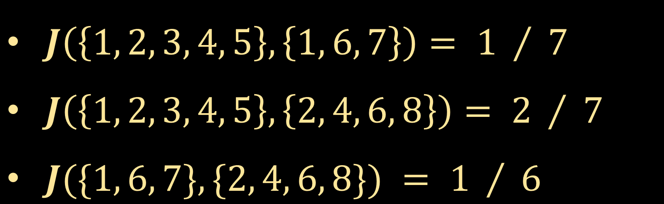
Jaccard Similarity Example 1
$$\left\{1, 2, 3, 4, 5\}, \{1, 6, 7\}, \{2, 4, 6, 8\right\}$$
$J\left(\left\{1, 2, 3, 4, 5\right\}, \left\{1, 6, 7\right\}\right)= 1 / 7$
$J\left(\left\{1, 2, 3, 4, 5\right\}, \left\{2, 4, 6, 8\right\}\right)= 2 / 7$
$J(\{1, 6, 7\}, \{2, 4, 6, 8\}) = 1 / 6$

Slide 9
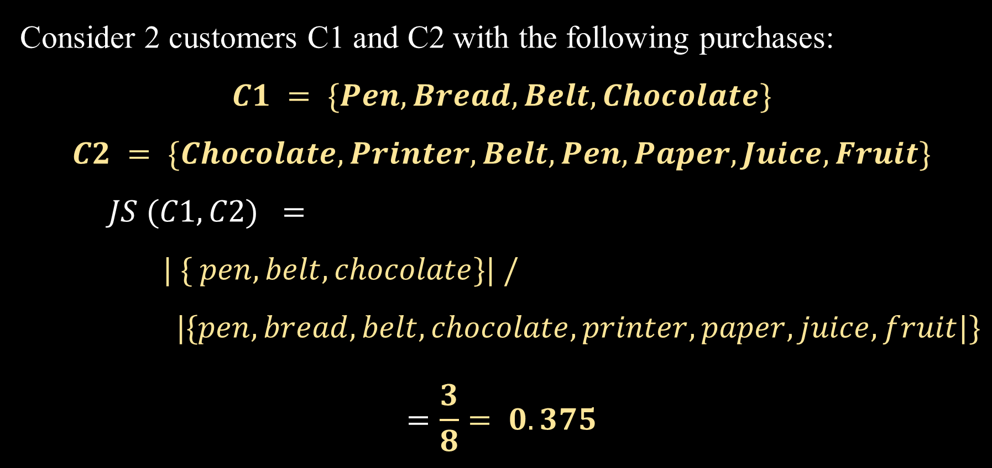
Jaccard Similarity Example 2
Consider 2 customers C1 and C2 with the following purchases:
$$C1 = \{Pen, Bread, Belt, Chocolate\}$$
$$C2 = \{Chocolate, Printer, Belt, Pen, Paper, Juice, Fruit\}$$
$JS (C1,C2) =$
$| \{ pen, belt, chocolate\}| / |\{pen, bread, belt, chocolate, printer, paper, juice, fruit|\}$
$$=\frac{3}{8}= 0.375$$

Slide 10
Document Similarity
Near-duplicate detection to improve search results quality in search engines
Human Resources applications, such as automated CV to job description matching, or finding similar employees
Patent research, through matching potential patent applications against a corpus of existing patent grant.
Document clustering and auto-categorization using seed documents
Security scrubbing - finding documents with very similar content, but with different access control lists

Slide 11
Plagiarism Detection
Turnitin is a web based system used for detecting and preventing plagiarism and improper citations in student homeworks, projects and papers.
Once loaded into the system, student works are compared against a vast database.
The system detects excerpts, suspicious similarities, uncited references etc. and produces a similarity report.
Turnitin's control database consists of academic databases, academic journals and publications, 200+ million student homework, 17+ billion web pages.

Slide 12
Document Similarity
Computing pairwise similarity on large document collections is a task common to a variety of problems such as clustering and cross-document co-reference resolution.
A web search engine often returns thousands of pages in response to a broad query, making it difficult for users to browse or to identify relevant information.
For example, Google along with every primary link that is shown on the result page includes a “Similar” link, which provides a link to a set of documents similar to the primary link.
Document similarity with respect to the query posed is evaluated and all similar documents are clustered and ranked. The primary link points to the top ranked page.

Slide 13
News Aggregators
Given multiple sources of documents, such as RSS news feeds, aggregators cluster together similar documents that cover the same material.
For instance, several news websites around the world would carry the news of “Germany Lifting the World Cup Football Title in 2014”. We wish to recognize that these are the same underlying story and cluster or aggregate them. However, the core of each newspaper’s page will be the original article.
News aggregators, such as Google News, try to find all versions of such an article, in order to show only one

Slide 14
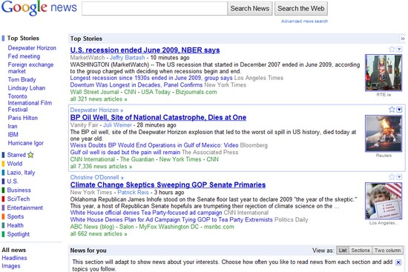

Slide 15

Distance Measures
A distance measure indicates the degree of dissimilarity between the two items.
Distance is a subjective measure and is highly dependent on the domain and application.
More formally, a distance function d is a distance metric if it is a function from pairs of objects to real numbers such that:
Non –Negative
Identity
Symmetric
Triangular Inequality

Slide 16
Euclidean Vs. Non-Euclidean
A Euclidean space has some number of real-valued dimensions and “dense” points.
There is a notion of “average” of two points.
A Euclidean distance is based on the locations of points in such a space.
A Non-Euclidean distance is based on properties of points, but not their “location” in a space.

Slide 17
Some Euclidean Distances
L₂ norm : d(x,y) = square root of the sum of the squares of the differences between x and y in each dimension.
The most common notion of “distance.”
L₁ norm : sum of the differences in each dimension.
Manhattan distance = distance if you had to travel along coordinates only.

Slide 18
Euclidean Distance
Distance Matrix

Slide 19
Examples of Euclidean Distances
b = (9,8)
L₂-norm:
dist(x,y) = √(4²+3²)
= 5
5
3
L₁-norm:
dist(x,y) =
4+3 = 7
4
a = (5,5)

Slide 20
Another Euclidean Distance
L∞ norm : d(x,y) = the maximum of the differences between x and y in any dimension.
Note: the maximum is the limit as n goes to ∞ of the L_{n} norm: what you get by taking the n ^{th} power of the differences, summing and taking the n ^{th} root.

Slide 21
Non-Euclidean Distances
Jaccard distance for sets = 1 minus Jaccard similarity.
Cosine distance = angle between vectors from the origin to the points in question.
Edit distance = number of inserts and deletes to change one string into another.
Hamming Distance = number of positions in which bit vectors differ.

Slide 22
Jaccard Distance for Sets (Bit-Vectors)
Example: p₁ = 10111; p₂ = 10011.
Size of intersection = 3; size of union = 4, Jaccard similarity (not distance) = 3/4.
d(x,y) = 1 – (Jaccard similarity) = 1/4.

Slide 23
Why J.D. Is a Distance Measure
d(x,x) = 0 because x∩x = x∪x.
d(x,y) = d(y,x) because union and intersection are symmetric.
d(x,y) > 0 because |x∩y| < |x∪y|.
d(x,y) < d(x,z) + d(z,y) (can be proved)

Slide 24
Cosine Distance
Think of a point as a vector from the origin (0,0,…,0) to its location.
Two points’ vectors make an angle, whose cosine is the normalized dot-product of the vectors: p₁.p₂/|p₂||p₁|.
Example: p₁ = 00111; p₂ = 10011.
p₁.p₂ = 2; |p₁| = |p₂| = √3.
cos(θ) = 2/3; θ is about 48 degrees.

Slide 25
Cosine-Measure Diagram
p₁
θ
p₂
p₁.p₂
|p₂|
d (p₁, p₂) = θ = arccos(p₁.p₂/|p₂||p₁|)

Slide 26
Why C.D. Is a Distance Measure
d(x,x) = 0 because arccos(1) = 0.
d(x,y) = d(y,x) by symmetry.
d(x,y) > 0 because angles are chosen to be in the range 0 to 180 degrees.
Triangle inequality: physical reasoning. If I rotate an angle from x to z and then from z to y, I can’t rotate less than from x to y.

Slide 27
Cosine Similarity
If d₁ and d₂ are two document vectors, then
cos( d₁, d₂ ) = (d₁ • d₂) / ||d₁|| ||d₂|| ,
where • indicates vector dot product & || d || is the length of vector d.
Example:
d₁ = 3 2 0 5 0 0 0 2 0 0
d₂ = 1 0 0 0 0 0 0 1 0 2
d₁ • d₂= 3*1 + 2*0 + 0*0 + 5*0 + 0*0 + 0*0 + 0*0 + 2*1 + 0*0 + 0*2 = 5
||d₁|| = (3*3+2*2+0*0+5*5+0*0+0*0+0*0+2*2+0*0+0*0)^{0.5} = (42) ^{0.5} = 6.481
||d₂|| = (1*1+0*0+0*0+0*0+0*0+0*0+0*0+1*1+0*0+2*2) ^{0.5} = (6) ^{0.5} = 2.245
cos( d₁, d₂ ) = .3150

Slide 28
Edit Distance
The edit distance of two strings is the number of inserts and deletes of characters needed to turn one into the other. Equivalently:
d(x,y) = |x| + |y| - 2|LCS(x,y)|.
LCS = longest common subsequence = any longest string obtained both by deleting from x and deleting from y.

Slide 29
Example: LCS
x = abcde ; y = bcduve.
Turn x into y by deleting a, then inserting u and v after d.
Edit distance = 3.
Or, LCS(x,y) = bcde.
Note: |x| + |y| - 2|LCS(x,y)| = 5 + 6 –2*4 = 3 = edit distance.

Slide 30
Why Edit Distance Is a Distance Measure
d(x,x) = 0 because 0 edits suffice.
d(x,y) = d(y,x) because insert/delete are inverses of each other.
d(x,y) > 0: no notion of negative edits.
Triangle inequality: changing x to z and then to y is one way to change x to y.

Slide 31
Variant Edit Distances
Allow insert, delete, and mutate.
Change one character into another.
Minimum number of inserts, deletes, and mutates also forms a distance measure.
Ditto for any set of operations on strings.
Example: substring reversal OK for DNA sequences

Slide 32
Hamming Distance
Hamming distance is the number of positions in which bit-vectors differ.
Example: p₁ = 10101; p₂ = 10011.
d(p₁, p₂) = 2 because the bit-vectors differ in the 3rd and 4th positions.

Slide 33
Why Hamming Distance Is a Distance Measure
d(x,x) = 0 since no positions differ.
d(x,y) = d(y,x) by symmetry of “different from.”
d(x,y) > 0 since strings cannot differ in a negative number of positions.
Triangle inequality: changing x to z and then to y is one way to change x to y.

Slide 34
Distance between categorical data points
Since we have no ordering between categorical values, we can only measure whether the categorical values are the same or not.
Basically we are measuring the degree that attribute values overlap.
Hamming distance can be used to measure how many attributes must be changed in order to match one another.
We can calculate the ratio to determine the similarity (or difference) between two data points using the simple matching coefficient: noOfMatchAttributes / noOfAttributes

